Slide 1

Fundamental Logic Design Chapter 6: Quine-McCluskey Method
Miami College of Henan University

Slide 2
This chapter includes:
6.1 Determination of Prime Implicants
6.2 The Prime Implicant Chart
6.3 Petrick’s Method
6.4 Simplification of Incompletely Specified Functions
6.5 Simplification Using Map-Entered Variables
6.6 Conclusion

Slide 3
Learning Objectives
Find the prime implicants of a function by using the Quine-McCluskey method. Explain the reasons for the procedures used.
Define prime implicant and essential prime implicant.
Given the prime implicants, find the essential prime implicants and a minimum sum-of-products expression for a function, using a prime implicant chart and using Petrick’s method.
Minimize an incompletely specified function, using the Quine-McCluskey method.
Find a minimum sum-of-products expression for a function, using the method of map-entered variables.

Slide 4
Introduction
Chapter Introduction:
The Quine-McCluskey method presented in this unit provides a systematic simplification procedure which can be readily programmed for a digital computer.
The Quine-McCluskey method reduces the minterm expansion (standard sum-of-products form) of a function to obtain a minimum sum of products.

Slide 5
Introduction
Chapter Introduction (continued):
The Quine-McCluskey procedure consists of two main steps:
Eliminate as many literals as possible from each term by systematically applying the theorem XY + XY = X. The resulting terms are called prime implicants.
Use a prime implicant chart to select a minimum set of prime implicants which, when ORed together, are equal to the function being simplified and which contain a minimum number of literals.

Slide 6
Determination of Prime Implicants
Forming Prime Implicants:
In the first part of the Quine-McCluskey method, all of the prime implicants of a function are systematically formed by combining minterms.
The minterms are represented in binary notation and combined using
XY+XY′=X
where X represents a product of literals and Y is a single variable.
Two minterms will combine if they differ in exactly one variable.

Slide 7
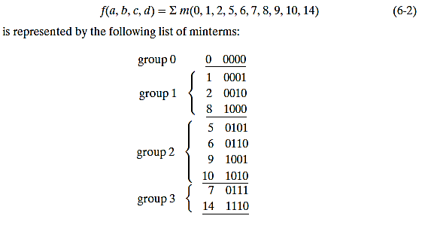
Determination of Prime Implicants
Determining Prime Implicants:
To reduce the required number of comparisons, the binary minterms are sorted into groups according to the number of 1’s in each term. Thus,

Slide 8
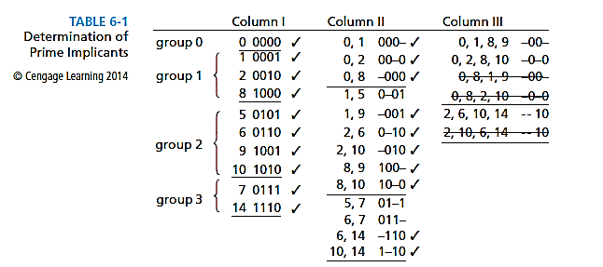
Determination of Prime Implicants
Determination of Prime Implicants:

Slide 9


Determination of Prime Implicants
Implicant and Prime Implicant:
The Quine-McCluskey method finds all of the product term implicants of a function. The implicants which are nonprime are checked off in the process of combining terms so that the remaining terms are prime implicants.

Slide 10
The Prime Implicant Chart
Prime Implicant Chart:
The prime implicant chart can be used to select a minimum set of prime implicants.
The minterms of the function are listed across the top of the chart, and the prime implicants are listed down the side.
A prime implicant is equal to a sum of minterms, and the prime implicant is said to cover these minterms.

Slide 11
The Prime Implicant Chart
Prime Implicant Chart:
If a prime implicant covers a given minterm, an X is placed at the intersection of the corresponding row and column.
Table 6-2 shows the prime implicant chart derived from Table 6-1. All of the prime implicants (terms which have not been checked off in Table 6-1) are listed on the left.
If a given column contains only one X, then the corresponding row is an essential prime implicant.
See next slide for Table 6-2.

Slide 12
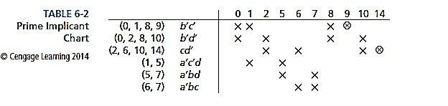
The Prime Implicant Chart
Prime Implicant Chart:

Slide 13
The Prime Implicant Chart
Prime Implicant Chart:
Each time a prime implicant is selected for inclusion in the minimum sum, the corresponding row should be crossed out. After doing this, the columns which correspond to all minterms covered by that prime implicant should also be crossed out.
Table 6-3 shows the resulting chart when the essential prime implicants and the corresponding rows and columns of Table 6-2 are crossed out.

Slide 14
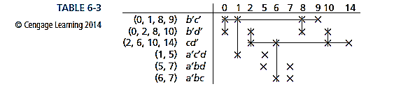
The Prime Implicant Chart
Prime Implicant Chart:

Slide 15
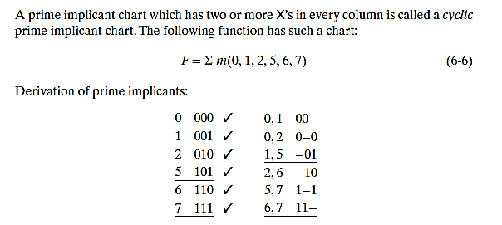
The Prime Implicant Chart
Example 1:

Slide 16
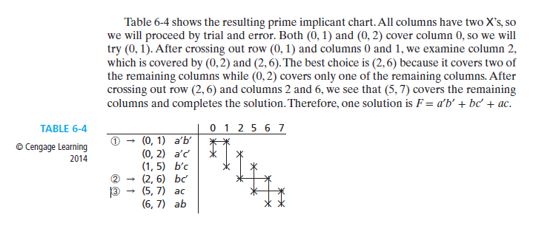
The Prime Implicant Chart
Example 1 (continued):

Slide 17
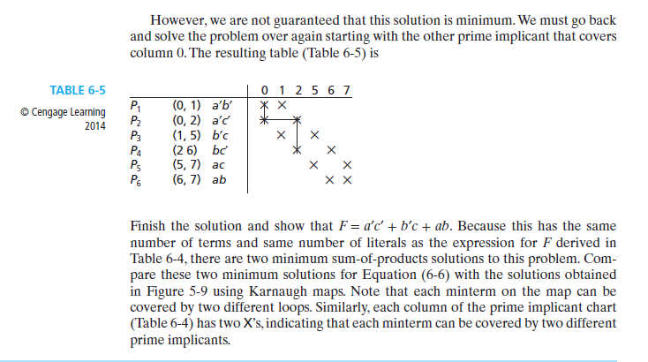
The Prime Implicant Chart
Example 1 (continued):

Slide 18
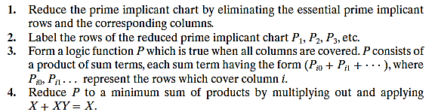
Petrick’s Method
General procedure:

Slide 19
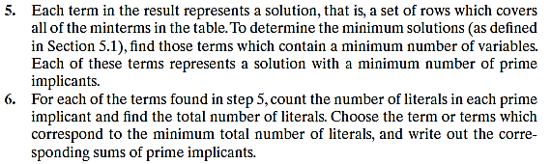
Petrick’s Method
General procedure (continued):

Slide 20
Simplification of Incompletely Specified Functions
Handling “Don’t Cares”:
In this section, we will show how to modify the Quine-McCluskey method in order to obtain a minimum solution when don’t-care terms are present.
In the process of finding the prime implicants, we will treat the don’t-care terms as if they were required minterms.
When forming the prime implicant chart, the “don’t cares” are not listed at the top.

Slide 21
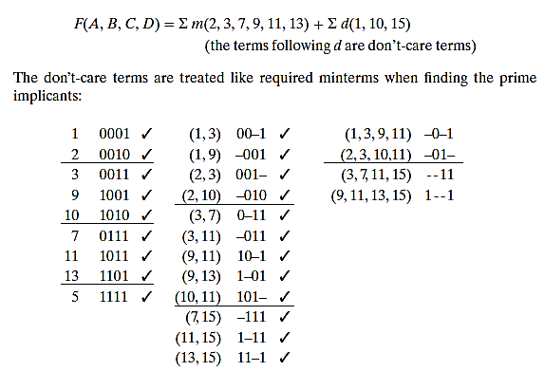
Simplification of Incompletely Specified Functions
Example 2:

Slide 22
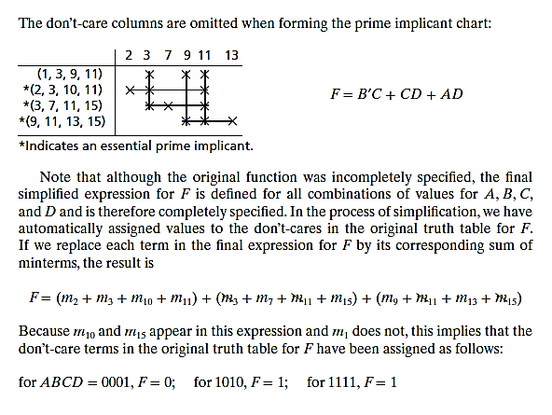
Simplification of Incompletely Specified Functions
Example 2 (continued):

Slide 23
Simplification of Incompletely Specified Functions
Example 2 (continued):

Slide 24
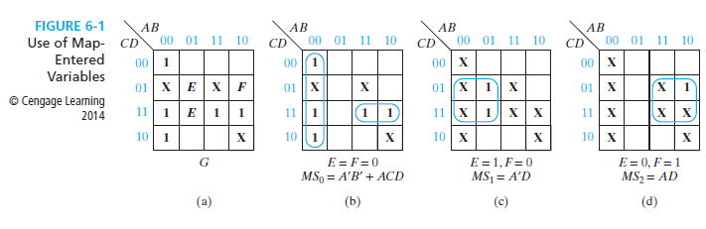
Simplification Using Map-Entered Variables
By using map-entered variables, Karnaugh map techniques can be extended to simplify functions with more than four or five variables.
Figure 6-1(a) shows a four-variable map with two additional variables entered in the squares in the map.

Slide 25
Simplification Using Map-Entered Variables
When E appears in a square, this means that if E=1, the corresponding minterm is present in the function G, and if E=0, the minterm is absent. Thus the map represents the six-variable function
where the minterms are the minterms of variables A,B,C, and D. Note that m₉ is only present in G when F=1.

Slide 26
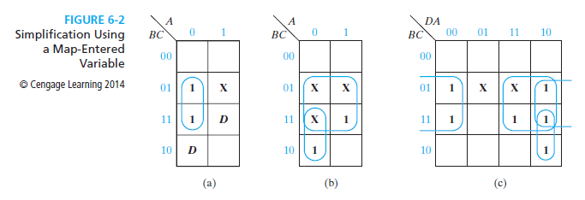
Simplification Using Map-Entered Variables
To simplify the following function,
D is chosen as the map-entered variable. See page 183 for further explanation.

Slide 27
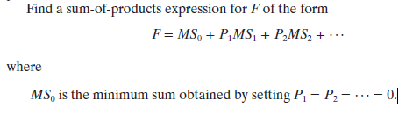
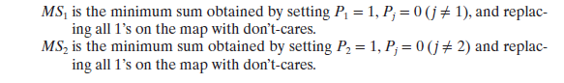
Simplification Using Map-Entered Variables
General Method of Simplifying Expressions Using Map-Entered Variables:

Slide 28
Homework
Please solve the following problems:
6.2, 6.4, 6.5, 6.6, 6.9, 6.11, 6.16, 6.21, 6.22, 6.25
Kindly, read chapter 6

